Slide 1


Stroke Prevention
Chronic Management of Atrial Fibrillation
Rate Control
Rhythm Control
Cases
Notes:
Image ref:, BioRender

Slide 2

Stroke Prevention
Stroke Prevention: Risk Assessment
Risk Assessment
Stroke risk tool?
Bleeding risk tool?
Stroke risk tool?
Bleeding risk tool?
C
H
Therapies
C
HF
H
TN (uncontrolled)
Clinical Scenarios
A
H
A
H
TN
bnormal kidney/liver function
Rate Control
S
A
S
A
ge (65-74 yo)
troke
Rhythm Control
B
D
B
D
iabetes
leeding history/predisposition
Cases
L
S₂
L
S₂
troke/TIA/embolism (+2)
abile INR
E
V
E
V
ascular disease
lderly (>65 yo)
D
A₂
D
A₂
ge (>75 yo) (+2)
rugs / EtOH
Sc
S_{c}
ex category (female)
68 yo M with HFpEF, HTN, DM, and CKD
51 yo F with no other PMH
68 yo M with HFpEF, HTN, DM, and CKD
Calculate
annual risk
51 yo F with no other PMH
Calculate
annual risk
CHADS-VASc 1: <1%/yr
HAS-BLED 0: <1%/yr
CHADS-VASc 4: 5-7%/yr
HAS-BLED 3: ~6%/yr
Notes:
Ref: https://pubmed.ncbi.nlm.nih.gov/22246443/
It is well established that patients with AF are at elevated risk of stroke and that anticoagulation can reduce that risk. The decision to start anticoagulation involves balancing the benefits of clot prevention with the risk of bleeding.
Stroke Assessment:
The CHA₂DS₂-VASc score is the most widespread risk assessment tool to assess stroke risk in non-valvular atrial fibrillation and is used to make decisions on when to initiate anticoagulation. Increasing scores are associated with increasing annual risk of stroke. The components of the score are listed below. Click on each of the letters to reveal the risk factor.
- Congestive heart failure: Any history of symptomatic heart failure (preserved or reduced ejection fraction) OR even asymptomatic left ventricular dysfunction on cardiac imaging
- Hypertension: history of hypertension, regardless of control
- Age: +1 for age 65-74, +2 for age ≥75
- Diabetes: any history of diabetes regardless of severity
- Stroke/TIA/systemic embolism (+2): Any history of stroke, transient ischemic attack, or systemic thromboembolism. Of note systemic embolism includes arterial embolism (i.e. deep venous thrombosis/pulmonary embolism is not included)
- Vascular disease: includes any history of coronary artery disease (including prior myocardial infarction, disease noted on angiography/other imaging, or angina) or peripheral vascular disease (including symptomatic claudication, history of peripheral intervention)
Sex category: Female sex is a “risk modifier,” in that for each non-sex risk factor, females tend to have a higher stroke risk than males
Bleeding risk assessment: HAS-BLED - Ask learners to name the bleeding risk assessment tool and then the individual components of the HAS-BLED. The most common tool used to assess bleeding risk is the HAS-BLED tool. The components are listed below. Note that there is significant overlap between the two risk scores: many risk factors that increase risk of stroke also increase risk of bleeding.
Hypertension (uncontrolled): systolic blood pressure > 160 mm Hg
Abnormal renal/liver function: 1 point for each, based on history (e.g. on dialysis) or laboratory values
Stroke: history of ischemic or hemorrhagic stroke
Bleeding history or predisposition: predisposition is not well defined, but would include coagulopathy and thrombocytopenia
Labile INR: for patients on warfarin
Elderly: Age >65
Drugs: Concomitant use of medications such as NSAIDs or antiplatelet, as well as “excessive” alcohol use

Slide 3


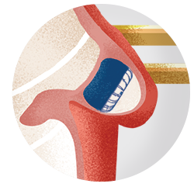
Stroke Prevention
Stroke Prevention: Therapies
When to anticoagulate?
Risk Assessment
When to anticoagulate?
High bleeding risk?
High bleeding risk?
Therapies
CHADS₂-VA₂Sc
Stroke risk/y
Address modifiable RFs.
Weigh risk/benefits of OAC.
0
0.2%
Clinical Scenarios
1
0.6%
2
2.2%
Functional disability from stroke
Rate Control
3
3.2%
↑ non-major bleeding
4
4.8%
Rhythm Control
5
7.2%
6
9.7%
OAC↓ stroke 64%, ↓ mortality 26%
Significance of stroke often > major bleed
Cases
7
11%
8
11%
9
12%
Non-medication options?
Non-medication options?
1st line therapy?
1st line therapy?
Percutaneous LAA occlusion
Surgical LAA ligation
DOACs > warfarin
(for most patients)
Paroxysmal vs. persistent?
Paroxysmal vs. persistent?
AF burden (or prior cardioversion) does not change anticoagulation decision
Notes:
The chart provided is from a 2012 validation study which highlights the high absolute risk of stroke in patients with atrial fibrillation, nearly 10% or great for patients with CHA₂DS₂-VASc 6 or more.¹
High bleeding risk?: In general, outside of an acute episode of bleeding, guidelines do not recommend withholding anticoagulation due to an elevated risk of bleeding, for the following reasons:
Anticoagulation is very effective, with >60% relative risk reduction of stroke and >25% relative mortality reduction.²
As discussed previously, as there is high overlap between bleeding and stroke risk, patients at high bleeding risk can derive more absolute benefit.
The clinical significance and consequences to the patient of an ischemic stroke are often more severe than an episode of bleeding (often defined by a hemoglobin drop or transfusion requirement in studies of bleeding risk).
According to cardiologists (and most neurologists) – even in the setting of high bleeding risk, the benefits of anticoagulation outweigh the risks.
I think you’ll find internists and PCPs have varying opinions on this, but this is a trend in the literature/practice.
They recommend addressing modifiable risk factors – stopping NSAIDS, controlling hypertension.
First line therapy?: Direct oral anticoagulants (DOACs) have been shown to be more effective and have lower bleeding risk than warfarin, and current guidelines recommend DOAC as first line for most patients. There is emerging evidence comparing one DOAC to another, but for now guidelines do not recommend one over the other.
Non-medication options?: For patients who cannot tolerate anticoagulation, there are a number of procedural options that reduce risk of stroke. There percutaneously placed devices (e.g. WATCHMAN) that occlude the left atrial appendage, which is where clots tend to form in atrial fibrillation. It is important to note that patients are at high thrombotic risk peri-procedurally and require anticoagulation or antiplatelet therapy for a period of time. For patients undergoing other cardiac surgery, surgical left atrial appendage ligation during the procedure reduces risk of stroke, but it is still recommended that patients continue oral anticoagulation.

Slide 4






Stroke Prevention
Anticoagulation: Clinical Scenarios
Risk Assessment
What if your patient has…
Therapies
Frequent falls
Valve disease
Frequent falls
Valve disease
Moderate to severe MS or mechanical valve
Warfarin
Clinical Scenarios
Continue OAC unless history of ICH
Rate Control
Rhythm Control
BMI
CAD
Obesity
CAD
Cases
Obesity
Any DOAC
In general, do not need ASA + OAC long term for stable CAD
40
Apixaban, rivaroxaban
50
Warfarin vs DOAC
Cardioversion
AF > 48h or unknown
Cardioversion
CKD
CKD
Apixaban or warfarin
if ESRD or CrCl < 15
OAC x 3w or
TEE DCCV
OAC x 4w
regardless of risk
Notes:
Valve disease - the term “valvular” AF refers only to moderate or severe mitral stenosis or a mechanical valve. Any other valvular lesion (e.g. aortic stenosis, mitral regurgitation) still falls under “non-valvular” atrial fibrillation. Patients with moderate to severe mitral stenosis were excluded from trials evaluating efficacy of DOACs and current guidelines recommend warfarin for these patients, though there may be more data in the future.
Patients with mechanical valves require warfarin. DOACs have been studied in this population and were found to be inferior.³
Obesity - there is concern about efficacy of fixed dose DOAC in patients with obesity as they were not included or under-represented in clinical trials. There is data to suggest all DOACs are safe and effective at BMI <40, that apixaban is safe and effective up to a BMI of 50, but that patients with extreme obesity with BMI>50 likely should be treated with warfarin. ⁴ There is also data showing apixaban and rivaroxaban are safe and effective for treatment of venous thromboembolism.⁵
PMID: 33812834 https://www.sciencedirect.com/science/article/pii/S2405500X21001225?via%3Dihub - retrospective study of 36k patients. DOACs were compared to warfarin and had better safety and effectiveness across all BMI categories including those with grade 3 obesity (BMI > 40). Granted, mean BMI was like 45.5 in this group so it doesn't say much for BMI>50.
PMID: 34491953 - Meta-analysis of 10 studies including 89k patients with BMI > 40. Mean BMI was 43.7. Found that the rate of systemic embolism was lower in DOAC group and major bleeding rate was also significantly lower in DOAC group. Subgroup analysis show this was lower in rivaroxaban and apixaban. Dabigatran showed noninferiority to warfarin in embolism but superiority in safety. I didn't see a subgroup analysis for BMI>50.
Cardioversion - Patients who are undergoing cardioversion are at elevated stroke risk in the peri-cardioversion period – it is thought that if a clot has formed in the left atrial appendage, return to sinus rhythm could dislodge that clot and lead to systemic emboli. Current guidelines recommend at least 3 weeks of anticoagulation prior to cardioversion if atrial fibrillation has been present for >48 hours (or unknown duration). An alternative (frequently seen for patients admitted to the hospital) is to perform transesophageal echocardiogram (TEE) prior to cardioversion to ensure there is no clot in the left atrial appendage. It is often difficult to definitively determine the exact timing of onset and there is data questioning the “48-hour rule” (retrospective data showing increased risk of stroke after only 12 hours, particularly in elderly patients). Thus, patients rarely proceed directly to cardioversion without TEE or preceding anticoagulation. After cardioversion, patients require 4 weeks of anticoagulation regardless of their CHA₂DS₂-VASc score.
Frequent falls - Frequent falls (especially without history of associated bleeding) should not be a reason to withhold anticoagulation. One study estimated that a “average-risk” elderly patient would have to fall 295 times per year for the risk of anticoagulation to outweigh the benefit.⁶ (1999)
Coronary artery disease - In general, in most patients with stable coronary disease (i.e., at least 1 year from any revascularization), adding aspirin to anticoagulation therapy only increases bleeding risk without decreasing thrombotic events. Most patients can be treated with anticoagulation alone. Recent ACC guidelines have helpful diagrams for management of antiplatelet and anticoagulant medications in a variety of clinical scenarios.⁷
Chronic kidney disease - For patients with end-stage renal disease or a creatinine clearance (CrCl) <15 mL/min, apixaban or warfarin can be used.
Just some food for thought. Perhaps defer to Cards or Heme.
However, another source supporting your conclusion is PMID: 3386594 (Can J of Cardiology, 2021)

Slide 5

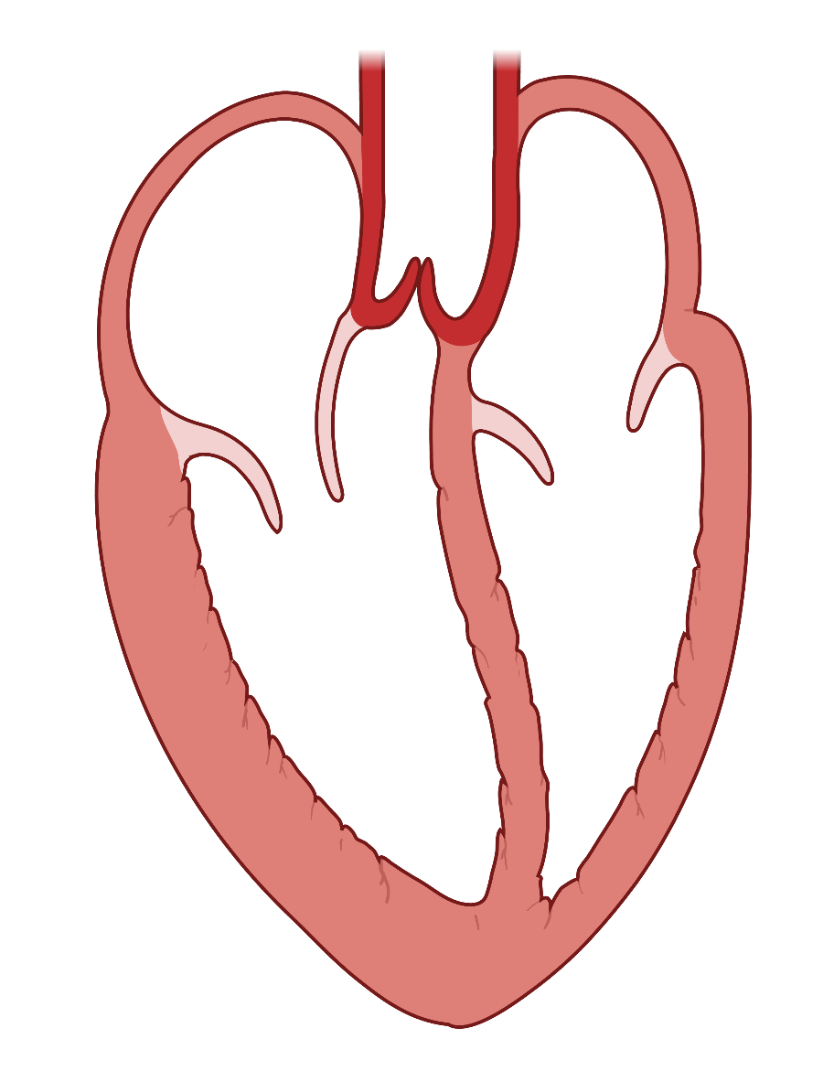
Stroke Prevention
Rate Control
Rate Control
What is the target HR?
What is the target HR?
Rhythm Control
Goal HR <110 for most patients
Stricter control (or rhythm control) if symptoms or declining LV function
Cases
Options for Rate Control?
Options for Rate Control?
Medication
Dose
Considerations
AV node
Metoprolol
Carvedilol
Bisoprolol
TDD 50-200 mg
TDD 6.25-50 mg
TDD 1.25-20 mg
Preferred in stable HFrEF
Caution in severe bronchospasm
Beta blockers
Beta blockers
CCBs
Avoid in HFrEF
CCBs
Diltiazem
TDD 120-480 mg
Second line, use as adjunct
Caution in CKD
Positive inotrope
Digoxin
125-250 mcg daily
Digoxin
Procedural option?
(Last line)
Procedural option?
(Last line)
AV node ablation with biventricular pacemaker placement (CRT)

Slide 6



Stroke Prevention
Rhythm Control
Historically…
Rate Control
Therapies?
Therapies?
Rhythm Control
Rhythm
control
Rate control
Cases
Factors that favor rhythm control?
Factors that favor rhythm control?
Anti-arrhythmic medications
Cardioversion
Anti-arrhythmic medications
Ablation
Patient history
Clinical Features
Patient History
Clinical Features
Symptomatic
Recent onset AF
Failed rate control
Tachy-induced cardiomyopathy
Younger age
Fewer comorbidities
Medications | Toxicity/Monitoring
Amiodarone | Pulmonary, thyroid, liver, drug interaction
Sotalol | QTc / TdP Renally dose
Dofetilide
Flecainide | Only if no structural heart disease
Risk reduction?
Risk reduction?
Smoking and ETOH cessation
Physical activity
Lose weight
Treat RFs
(DM, HTN, HLD, OSA)

Slide 7
Stroke Prevention
Case 1a
Case 1b
Case 1c
Rate Control
59 yo M with HLD, OA on chronic NSAIDs presents with dyspnea on exertion. On exam, he is found to have AF with a HR of 115 bpm. BMI is 45. TTE shows LVEF 58% without valvular disease.
A few weeks later, he returns to clinic. HR at home has been in the 95-110 bpm. He has ongoing dyspnea.
Five years later, he is admitted for a GI bleed due to a gastric ulcer and intermittent AF.
Two years after this, he returns to clinic for a follow-up. He is now 66 yo. His vital show BP is 165/90 with normal HR. ECG confirms normal sinus rhythm. He denies any episodes of dyspnea.
Rhythm Control
Rate control?
Cases
Consider ↑ rate control to target ↓ HR, as this may help with symptoms.
Rate control?
1
Goal HR <110 bpm. A beta-blocker (e.g., metoprolol) or calcium channel blocker (e.g., diltiazem) can be used in this setting.
Rhythm control?
Rate and rhythm control?
2-3
Consider rhythm control given persistent symptoms.
Reduce risk by managing comorbidities (weight loss, statin for HLD, screen for OSA and substance use).
Currently in sinus rhythm. No rate control need unless he continues to have paroxysms of AF.
Rhythm control?
Start anticoagulation?
Besides new onset AF, he has no RFs that favor rhythm control (young age, few comorbidities). It is reasonable to trial rate control first.
…He is scheduled for cardioversion.
He has paroxysmal AF. There is risk of stroke. Annual stroke and bleeding risk is:
CHADS-VASc 2 (age, HTN)
HAS-BLED 4 (age, bleeding history, NSAID use, uncontrolled HTN)
Shared decision making. Consider anticoagulation with close monitoring and assessment of modifiable RFs: BP control, stop NSAIDs, follow up with GI.
Anticoagulation?
Anticoagulation?
Before cardioversion: 3 weeks of OAC or TEE with cardioversion
After cardioversion: 4 weeks of OAC even though his CHADSVASC is 0
Use apixaban or rivaroxaban due to BMI
CHADS-VASc: 0. HAS-BLED 1 (NSAIDs). Anticoagulation not indicated.

Slide 8
Stroke Prevention
Case 2
Case 3
Rate Control
Choose a strategy for stroke prevention in the following patients with AF.
What would you use for rate control of AF in the following agents?
Rhythm Control
75 yo M with HTN and moderate-severe aortic stenosis
75 yo M with HFrEF (EF 38%)
Cases
CHADs-VASc 3. Anticoagulate with any DOAC. Only mitral valve or mechanical valve disease is “valvular” AF.
Evidence based beta-blocker: metoprolol succinate, carvedilol, or bisoprolol
1
82 yo F with HTN, HLD, CKD stage IV. Baseline Cr 2.4.
55 yo F with severe asthma and normal LV function
2-3
CHADS-VASc 4. Anticoagulate with apixaban 2.5 mg BID (preferred for CrCl < 15). Reduced dose of apixaban (2.5 vs 5 mg BID) is given if patients have any 2 of the following: age ≥80, weight ≤60 kg, or Cr ≥1.5.
Calcium channel blocker, diltiazem most commonly used.
Avoid beta-blocker in patients with severe airflow obstruction.
62 yo M with mildly decompensated HFrEF, on metoprolol succinate 50 mg daily. HR >120. Renal function normal.
62 yo M with severe obesity with BMI 55, DM type II, PAD.
Cautious up-titration of beta-blocker vs. addition of digoxin as an adjunct given HFrEF.
CHADS-VASc 2. Anticoagulation is recommended. Given BMI > 50, discuss risks and benefits of warfarin vs. apixaban or rivaroxaban. There is limited data but his BMI is not an absolute contraindication to DOAC. Consult with a pharmacist.
62 yo M above with HFrEF. Started on digoxin and increased metoprolol without improvement in HR. SBP 90-100.
78 yo F with prior CVA with left sided weakness on aspirin, CAD, and frequent falls. History of NSAID related PUD with GI bleeding requiring a transfusion.
Cardiology referral for consideration of rhythm control or AV node ablation with pacemaker placement. Hypotension limits uptitration of metoprolol and lack of rate control with digoxin.
CHADS-VASc 4 (4.8% annual stroke risk). HASBLED 4 (8.9% risk of bleeding). However, anticoagulation should still be considered. Risk of functional debility from stroke outweighs risk of nonmajor bleeding. Any DOAC could be considered.

Slide 9
2024 Update — 2023 ACC/AHA/ACCP/HRS AF Guideline
Staging: AF now staged 1 (at-risk) → 2 (pre-AF) → 3 (AF: 3A paroxysmal, 3B persistent, 3C long-standing, 3D post-ablation) → 4 (permanent). Replaces duration-only labels.
Anticoagulate by absolute risk: ≥2%/yr stroke risk → OAC (Class 1) — ≈ CHA₂DS₂-VASc ≥2 men / ≥3 women; score 1(m)/2(f) reasonable (2a). Use the score to estimate risk, not as a rigid cutoff.
DOAC over warfarin (Class 1): warfarin only for mechanical valve or moderate–severe mitral stenosis. The term “nonvalvular AF” is de-emphasized.
Catheter ablation upgraded: Class 1 first-line rhythm control in selected symptomatic paroxysmal AF (younger, few comorbidities) AND in AF with HFrEF.
Lifestyle is a pillar: weight loss (target BMI <27), alcohol reduction, BP control, OSA screening improve rate- and rhythm-control success.
LAAO (e.g., WATCHMAN): upgraded to Class 2a when there is a long-term contraindication to anticoagulation.

Slide 10
Take-Home Points
1. Use CHA₂DS₂-VASc to estimate annual stroke risk; anticoagulate at ≥2%/yr (≥2 men / ≥3 women) and in ALL patients peri-cardioversion regardless of score.
2. DOACs are first-line for most AF. Apixaban is usable in high BMI and ESRD/CrCl <15. Warfarin only for mechanical valve or moderate–severe mitral stenosis.
3. Rate control to HR <110 bpm for most (beta-blocker or non-dihydropyridine CCB; digoxin as adjunct, esp. in HFrEF). Diltiazem is contraindicated in HFrEF.
4. Persistent symptoms most strongly favor rhythm control; the 2023 guideline makes catheter ablation Class 1 first-line in selected patients and in AF + HFrEF.

Slide 11
Attribution & Optimization Changelog
Source: TeachIM.org — “Chronic Atrial Fibrillation Management,” Jonathan Lipsey MD & Kelsey Flint MD; exec. editor Yilin Zhang MD. Published Dec 2022. Licensed CC BY-NC 4.0 (non-commercial, attribution required).
Optimized June 2026: original drew on the 2019 ACC/AHA/HRS + 2020 ESC guidelines. Added the 2023 ACC/AHA/ACCP/HRS update (AF staging; absolute-risk anticoagulation; DOAC Class 1; catheter ablation Class 1 first-line; LAAO 2a; lifestyle pillar) on the preceding slide and in the companion package.
Deck edit: append-only — original interactive animations, graphics, and slide order preserved; no factual errors found in the original content.
Companion package: HTML lesson hub, 1-page clinical reference (PDF), 16 Anki cards, 5 board-style MCQs, and an EMR dotphrase.
Educational use only; verify dosing and current guidance before teaching.

